Slide 1
Purpose/Mission of ABD
2013
1932
Determine “competence”, prescribe standards of “fitness”, conduct exams to test qualifications of voluntary candidates and grant certificates
Publish the list of physicians who have been certified for the benefit of hospitals, medical schools, other physicians, and the lay public
Improve standards by investigating medical school criteria and encourage adequate facilities for instruction
(Now ACGME/RRC)
The American Board of Dermatology exists to assure safe, high quality dermatologic care for the public by setting, promoting and assuring standards of excellence in the practice of our specialty. The American Board of Dermatology is a voluntary, non-profit, private, autonomous organization formed for the primary purpose of protecting the public interest by establishing and maintaining high standards of training, education and qualifications of physicians rendering care in dermatology. The objective of all of its activities is to provide assurance that a diplomate of the Board possesses and maintains the knowledge and skills essential for the provision of superior, specialized care to patients with cutaneous diseases.

Slide 2
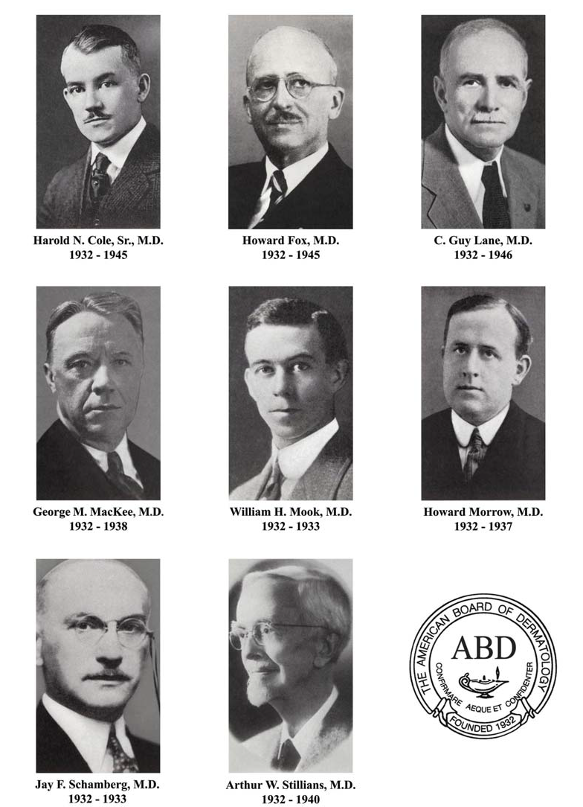
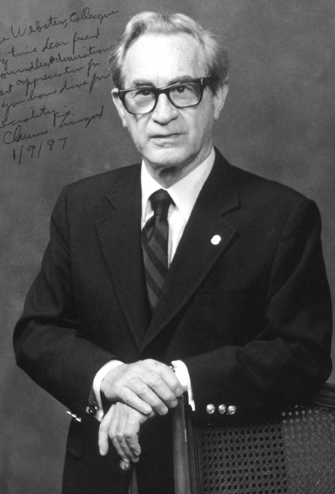
Founders American Board of Dermatology 1932
Clarence Livingood, MD
1964 – 1968 Secretary-Treasurer
1969 – 1992 Executive Director
1993 – 1998 Executive Consultant
Cole – Cleveland
Fox – NY
Lane – Boston
MacKee – NY
Mook – St. Louis
Morrow – SF
Schamberg – Phil.
Stillians - Chicago

Slide 3
Requirements for Certification (1933-1948)
Group A
Founders Group
  Adequate training
  Practice limited to dermatology for 10+ years
  Oral examination
  Clinical
  Laboratory - dermatopathology mycology
  ADA member
  Professional rank
    Teach in a Class A medical school
    5 years
    15 years practice limited to dermatology and syphilology
63 “Grandfathers”
$35 Fee
Group B
  Practice for 5+ years
  2 years of training in dermatology
  Written and oral examinations

Slide 4
The Exam from 1933 to 1947
One annual examination:
Written (essay) and oral components
(Omitting the written examination often discussed)
Oral examination:
Loose-leaf book of suitable questions
Classified into 11 sections
Prepared by the president and secretary
All members of the board would examine each candidate
Except the secretary; administrative duties

Slide 5
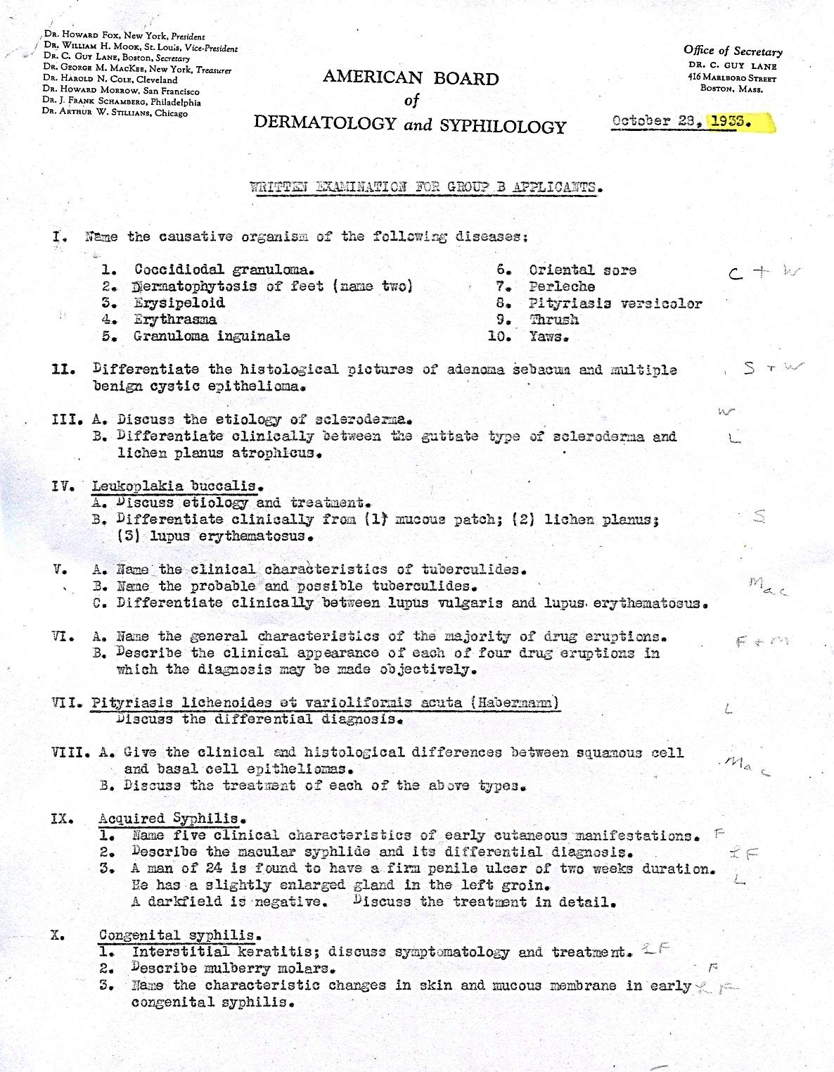
First Written Exam October 28,1933
Group B applicants
27 candidates
7 failures

Slide 6
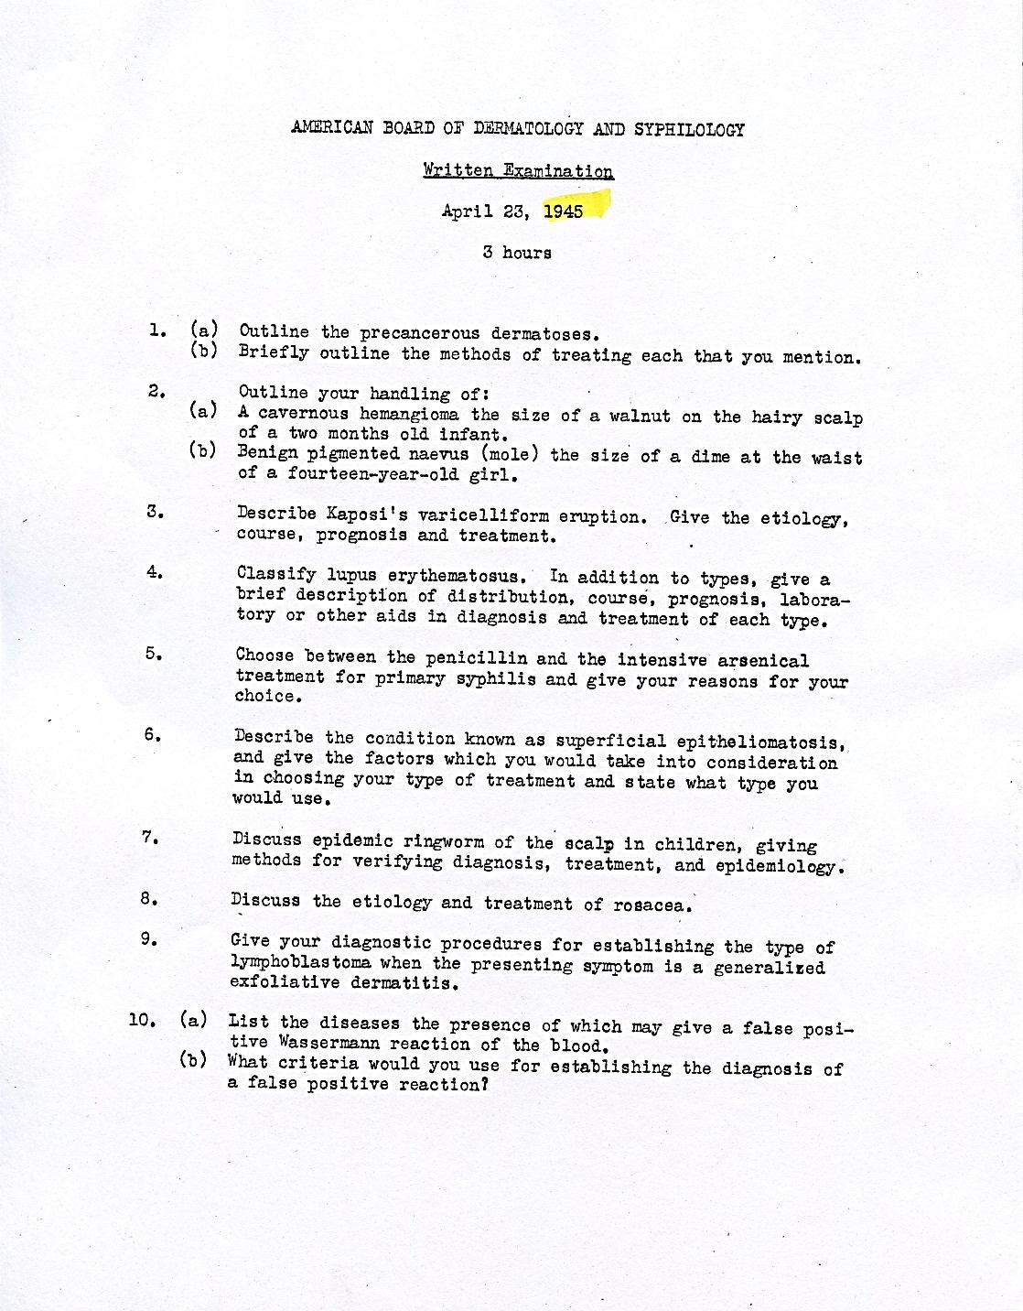
Essay style written exam given 1945

Slide 7
The Exam from 1948-1975
Written and Oral
Written examination used for screening
Candidates required to pass the written exam before taking the oral exam
Essay-type written exam
True-false questions (1949)
Multiple choice questions added later

Slide 8
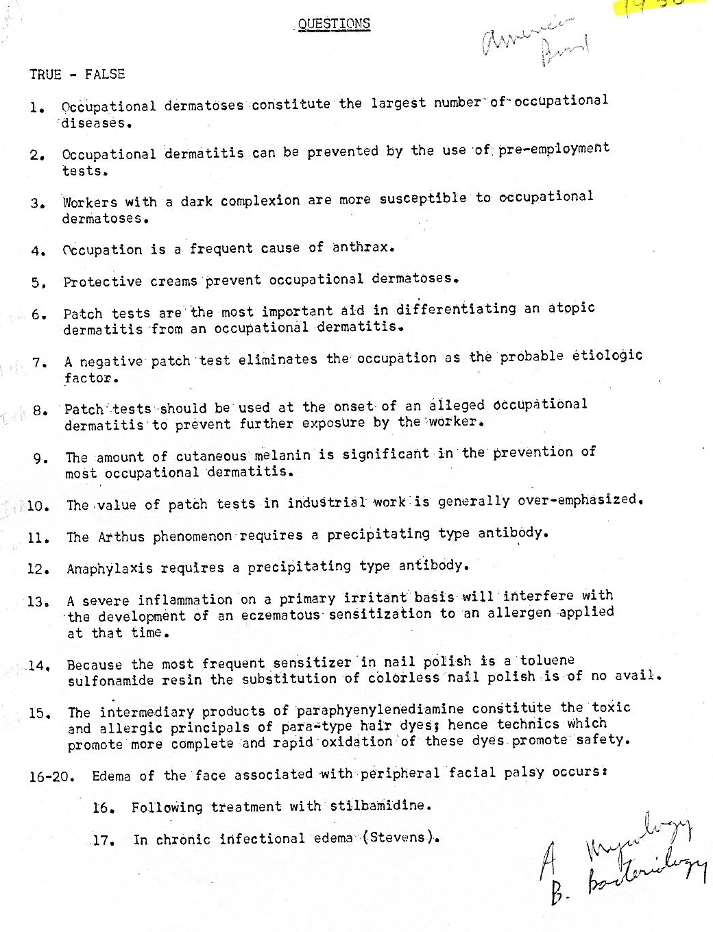
True/False Exam 1956

Slide 9
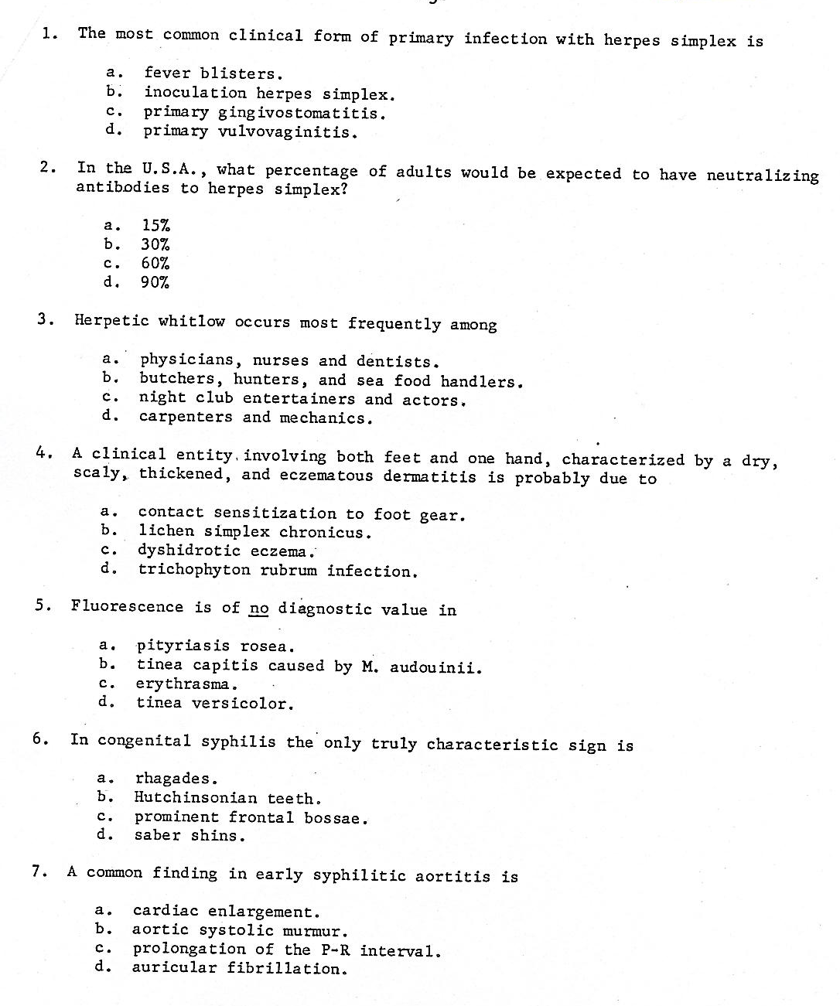
Multiple Choice Exam 1965

Slide 10
Oral Examinations
Single exam given at institutions across the country
3-5 day exam
Training center made available about 50 patients for case discussions (two parts; separate cases)
Both parts had to be passed to be successful on the exam
Candidates who failed could be “conditioned” and repeat that part of the exam
1951 - kodachrome slides included in the oral examination
1967 to 1975 - Two exams per year, different sections of the country; due to increasing numbers of candidates
1975 - last oral exam

Slide 11
Selected Oral Exam Dates and Locations
December 15 & 16, 1933 (New York)
June 11, 1934 (Cleveland)
October 15, 1955 (Washington, DC)
September 26-28, 1970 (Rochester)
October 24-27, 1970 (Baltimore)
September 2-4, 1971 (Portland)
November 5-7, 1971 (Ann Arbor)
September 22-23, 1972 (Oklahoma City)
October 26, 1972 (Philadelphia)
September 14 & 15, 1973 (New York)
October 25-27, 1973 (Galveston)
September 6 & 7, 1974 (Cleveland)
October 24, 1974 (Houston)
September 12, 1975 (Denver)
October 25-29, 1975 (Durham)
First Exam
New York Dec. 15-16, 1933
Last exam
Durham, NC Oct. 25-29, 1975
Roenigk proctored (1974)

Slide 12
The Decision to End Oral Exams
Report of Dr. Kopf’s Committee (1975)
Logistic issues associated with organizing patients, disrupting clinic at training programs and the time spent by each director giving the exam to each candidate
A limited number of examinees could see each patient so the test experience was different between examinees
Advocates for the oral exam wanted to retain the one-on-one test experience along with the use of live patients for the examination
The board decided it wanted a certifying exam that is “valid, defensible, reliable, consistent, thorough, discerning and comprehensive”.
Essential that all candidates be treated alike; impossible with an oral exam
Must not discriminate in favor of one candidate over another based on which patient they are assigned to examine and by which director
The board had never discussed, even superficially, what they expected to cover in the oral exam process
An experimental “practical” exam was proposed and the last oral exams were given at Duke and the University of Colorado

Slide 13
In Training Exam (1969)
Given every 2 yrs. until 1976 then given annually
Goltz, Wheeler report from ABMS on ABIM’s ITE (1973)
Administered by PD’s; could supplant oral exam
Implications for recertification, a concept supported 11 ABMS Boards
Report from ABIM (1992, 2007):
“The IM-ITE remains a valid predictor of performance on the IM-CE and continues to have construct validity for assessing medical knowledge acquired over time in a training program.”
Babbott, Beasley, Hinchey, Blotzer, Holmboe, The Predictive Validity of the Internal Medicine In-Training Examination. Am. J. Med., Vol. 120, No 8, August 2007

Slide 14
ITE
1969-2002
2003- Present
Examination booklets and answer sheets mailed to the training programs
Results were scored by Dr. Edward Swanson from 1969 until his death in 1993
ABP scored ITE (1993-2002)
NBME administered and scored the examination (2003-2010)
Measurement Inc. (2011 – present)
Given online to volunteer programs (2002)
Administered online (2003- present)

Slide 15
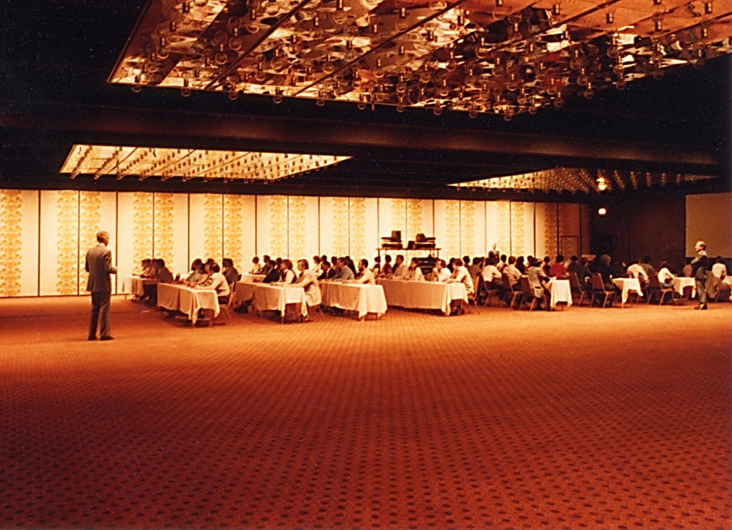
Holiday Inn Era (1976 – 2008)
Oct. 1975 - 29 candidates took an experimental “practical” exam before the first official “practical” exam in 1976.
The costs associated with doing the exam in this fashion caused exam fees to double. In constant dollars exam fees are about the same today as they were in 1976.

Slide 16
Holiday Inn Rosemont
Centrally located; room large enough to accommodate all candidates
1979 to 2003 - Separate Part I and Part II Multiple Choice Exam. If a candidate failed one part, they only needed to retake that part. NBME administered and validated the exam.
Two-day exam
Paper and pencil
Kodachrome clinical slides (digital images 2005)
Microscopes used to view dermatopathalogy slides
Part I Basic Science - multiple choice questions
Part II Part IIA (clinical and laboratory dermatology - images)
Part IIB (dermatopathology – glass slides)
1990 - Last lifetime certificate issued
1991 - Professional proctors first used
2004 - Surgical dermatology was added to Part IIA which then became known as Part II A&B
Dermatopathology became Part IIC
2007 - Examination administered on one day and only one score given (no Part I or Part II); psychometrics determined no statistical difference in outcome if we cut the number of questions in half

Slide 17
ABD Test Committees
All questions written by ABD Directors until 1986
Part I & II Test committees formed (1978)
Test committees add non-Director members (1986)
Test Committees Restructured (2007)
Content Development Committees
Examination Development Committees

Slide 18
References
American Medicine and the Public Interest: A History of Specialization
Rosemary Stevens (1971, 1998)
The American style of medicine (1900-1970)
“specialized, disorganized, expansionary and flamboyant”
“Arguably, the structure of the medical profession is moving toward a system of specialties defined by the job market rather than by the professional system of specialist qualifications.”
Death of the Guilds
Elliott Krause 1999
American Medicine: The Fall of a Giant
“No profession in our sample has flown quite as high in guild power and control as American medicine, and few have fallen as fast. The particular forces that accounted for the rise in the profession in 1930-1965 have all contributed to the decrease of professional autonomy and group guild power since that period.”
Livingood, History of the Am. Bd. Dermatology (1932-1982). JAAD 1982 7(6) 821-850

